Slide 1

Classification of Breast Cancer using Transfer Learning models
Team Members
Amogh Targe (IEC2020018)
Neeraj Gupta (IEC2020083)
Yashpal Chauhan (IEC2020134)
Under the guidance of:
Dr. Ramesh K Bhukya

Slide 2
Table of Content
Introduction
Literature
Dataset
Methodology
Flowchart
Methodology/ CNN Architecture
Results & Evaluation Metrics
Conclusion and Future Work

Slide 3
Introduction
Most commonly diagnosed cancer type in the world in 2020.
Breast cancer: malignant breast cell growth.
Classification by cell behavior and impact.
Early detection increases survival by 8%..
WHO predicts Breast Cancer incidence to rise by 2040.
Automated breast cancer detection is challenging.

Slide 4
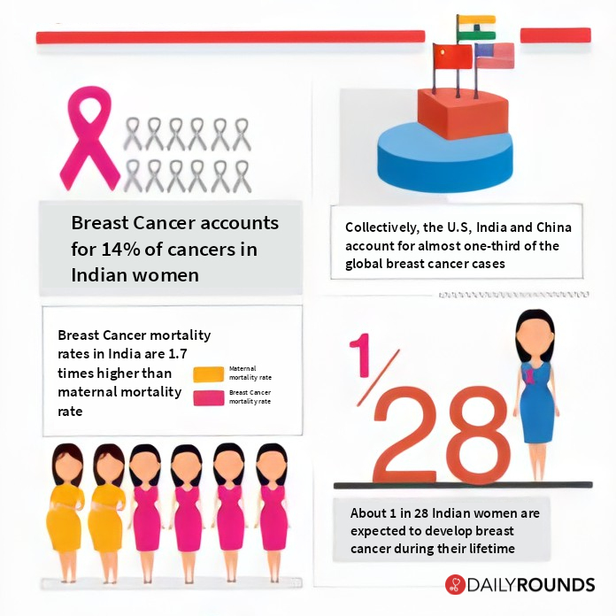
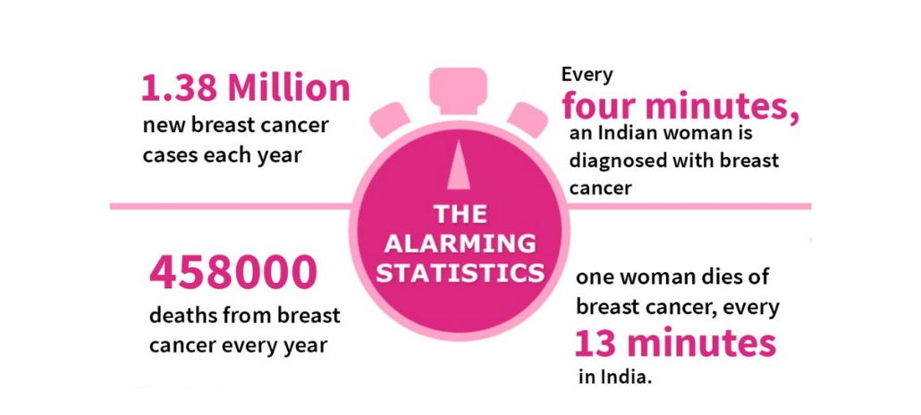
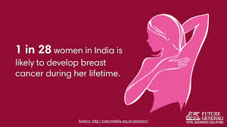
IARC estimates that by 2040 the incidence of breast cancer will increase by more than one third, to more than 3 million new cases per year, and breast cancer mortality will increase by more than one half, to more than 1 million deaths per year.
https://cancerconsultindia.com/blog/breast-cancer-statistics-rise-of-breast-cancer-in-india/

Slide 5
Literature Survey
Research papers related to Multi-class classification of Breast Cancer abnormalities using Deep CNN & other Architectures.
We studied some approaches to enhance classification of breast cancer abnormalities.
We also reviewed advantages and shortcomings of the papers.
Designed our approach.

Slide 6
Paper No | Paper Title and Author Name | Method Used | Accuracy
1. | Y. Li, J. Wu and Q. Wu, "Classification of Breast Cancer Histology Images Using Multi-Size and Discriminative Patches Based on Deep Learning" | ResNet50-128 and SVM | 88.89%
2. | Maleika Heenaye-Mamode Khan, Nazmeen Boodoo-Jahangeer, Wasiimah Dullull, Shaista Nathire, Xiaohong Gao, G. R. Sinha, Kapil Kumar Nagwanshi Modality Specific CBAM-VGGNet Model for the Classification of Breast Histopathology Images via Transfer Learning | VGG-16 and VGG-19 based model | 96.57%
3. | A. Saber, M. Sakr, O. M. Abo-Seida, A. Keshk and H. Chen, "A Novel Deep-Learning Model for Automatic Detection and Classification of Breast Cancer Using the Transfer-Learning Technique" | Transfer learning and SGDM( stochastic gradient-descent method with momentum) | 98.96%
4. | F. Shahidi, S. Mohd Daud, H. Abas, N. A. Ahmad and N. Maarop, "Breast Cancer Classification Using Deep Learning Approaches and Histopathology Image: A Comparison Study" | ResNeXt, Dual Path Net, SENet, and NASNet | 97.5%
5. | J. Zheng, D. Lin, Z. Gao, S. Wang, M. He and J. Fan, "Deep Learning Assisted Efficient AdaBoost Algorithm for Breast Cancer Detection and Early Diagnosis" | Deep learning assisted efficient | 97.3%

Slide 7
Objective
The main contribution that we intend to do in this project is summarized as follows:
Apply a pre-trained model and will devise ways to overcome overfitting models.
Develop an CNN model by using Adam Optimizer.
To consider ways of using the learning rate in an adaptive manner
during training.

Slide 8
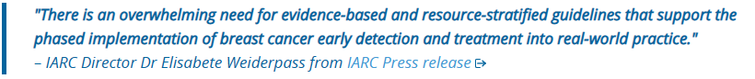
Problem Statement
To design an algorithm to automatically classify whether a patient is suffering from breast cancer or not by analysing the Histopathological images.

Slide 9
Dataset:
Breast Cancer Histopathological Database (BreaKHis)
The Breast Cancer Histopathological Image Classification (BreakHis) is composed of 9,109 microscopic images of breast tumour tissue collected from 82 patients using different magnifying factors (40X, 100X, 200X, and 400X).
To date, it contains 2,480 benign and 5,429 malignant samples (700 X 460 pixels, 3-channel RGB, 8-bit depth in each channel, PNG format).
Magnification | Benign | Malignant | Total
40X | 652 | 1370 | 1995
100X | 644 | 1437 | 2081
200X | 623 | 1390 | 2013
400X | 588 | 1232 | 1820
Total Images | 2480 | 5249 | 7909
We will be using images with magnification of 400X.

Slide 10
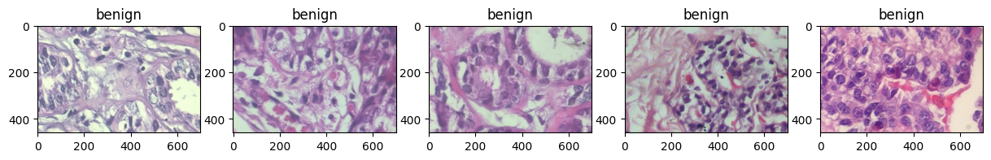
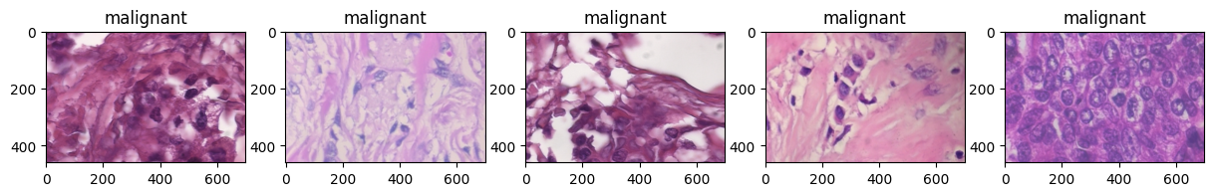
Visualizing Dataset

Slide 11
Methodology
Image classification by Convolutional Neural Networks (CNNs) with State of the Arts architecture.
Transfer learning.
BreaKHis dataset.
Various Optimizations.

Slide 12
Methodology
The CNN model will be built on Deep CNN Architecture.
The implementation consists :
Data Augmentation - Images are randomly zoomed, rotated, horizontally and vertically flipped to increase the size of our dataset. This causes less familiarity in data and reduces overfitting.
Classification - We have used Adam’s optimizer to classify the dataset into two categories i.e benign and malignant.

Slide 13
Methodology
CNN is trained by feeding it input to the first layer for feature extraction.
Error is calculated.
Parameters are tuned to minimize this error recursively until the model accuracy improves.
The convolutional layers use the images for feature extraction, and then the pooling layers are used for feature choosing. (Principal Component Analysis).

Slide 14
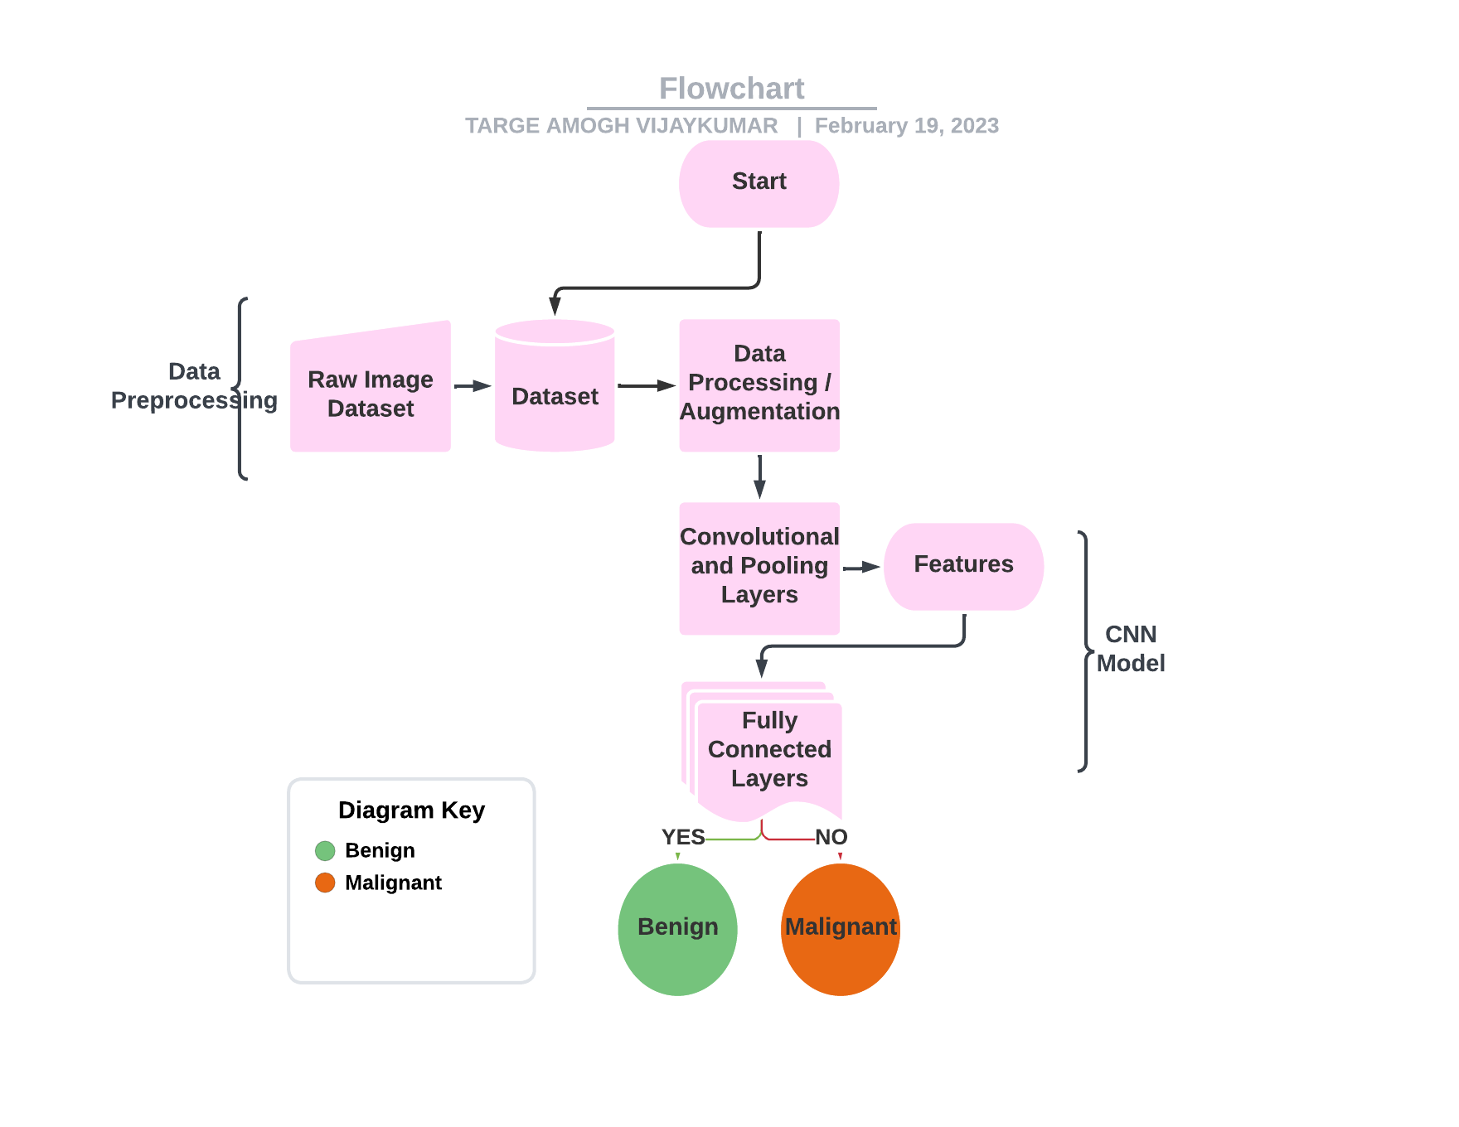
Flowchart
Input
Build Model
Compare Accuracy
Load Data / Augmentation
Evaluate Model
Data Augmentation: Randomly zoomed, flipped, rotated images

Slide 15
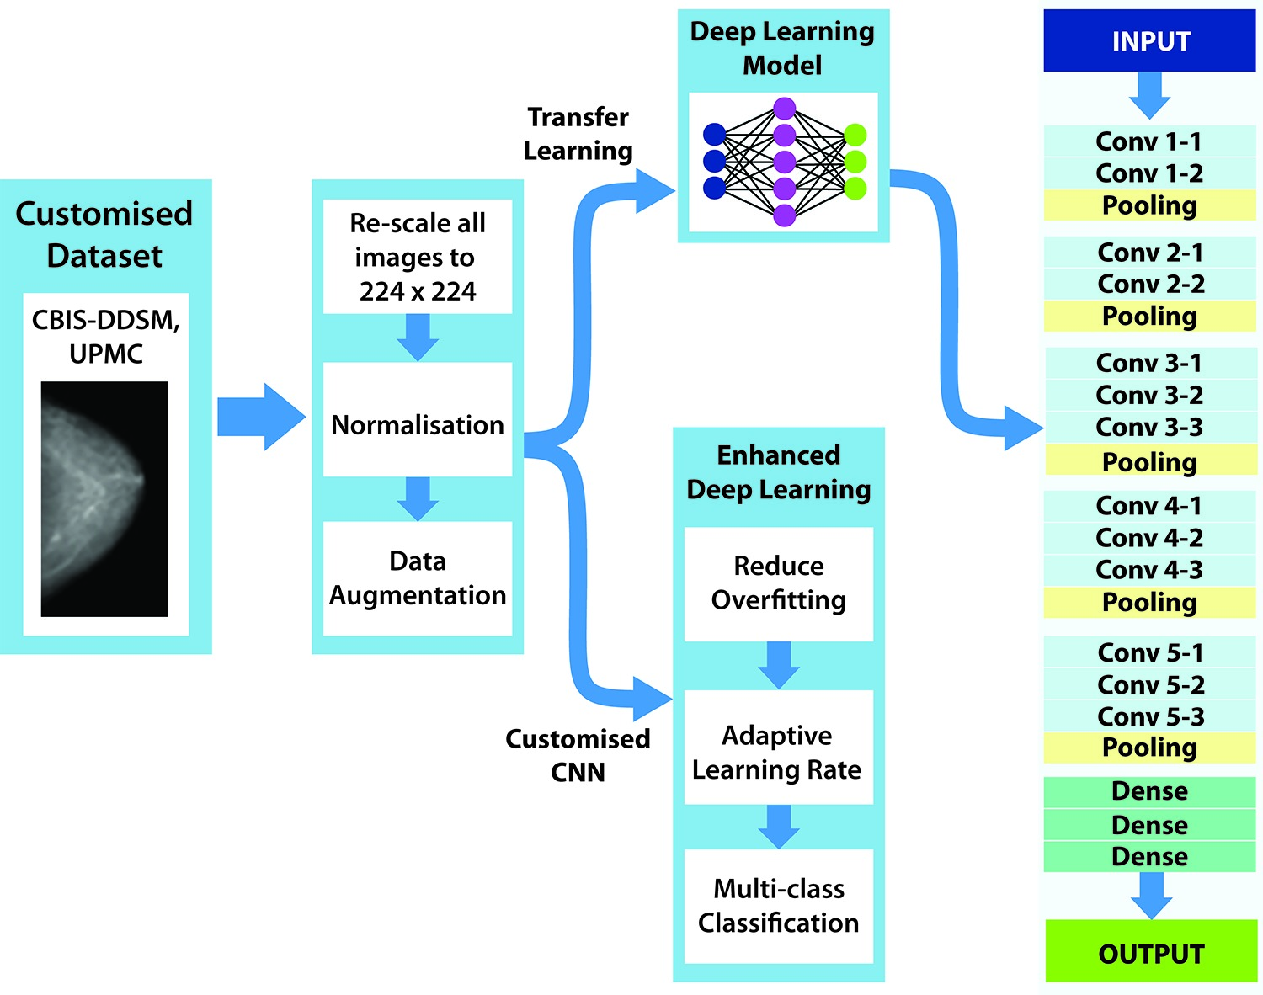
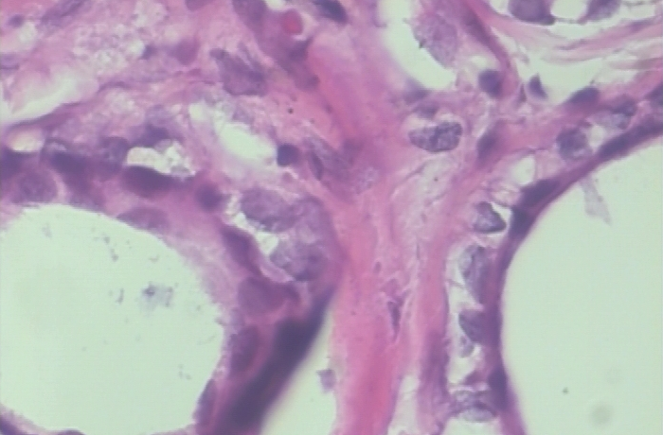
Architecture
BreakHis
Blocks
Convolutional Layers
Pooling Layers
https://doi.org/10.1371/journal.pone.0256500.g001

Slide 16
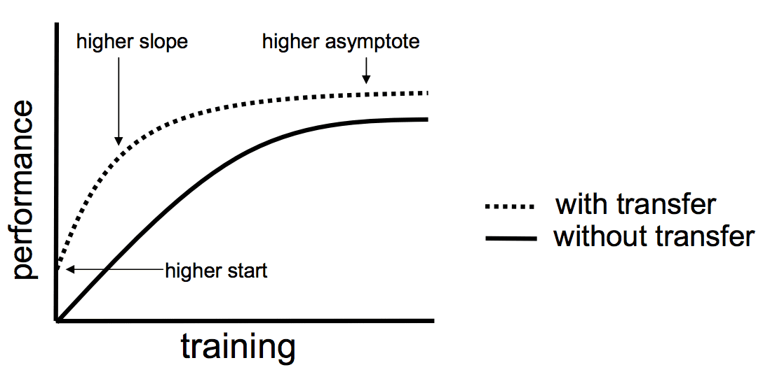
Benefits Of Transfer Learning
Transfer learning will help the engineers to perform deep learning tasks with very less data and resources.
Using a suitable pre-trained model will help to produce more accurate results
Transfer Learning speedup training process.
One of the biggest limitations of transfer learning is the problem of negative transfer.
Transfer learning only works if the initial and target problems are similar enough for the first round of training to be relevant. Developers can draw reasonable conclusions about what type of training counts as “similar enough” to the target, but the algorithm doesn’t have to agree.

Slide 17
Model Description
RESNET152V2
DENSENET201
VGG16
Xception
InceptionResNetV2

Slide 18
ResNet152V2
ResNet152V2 (Residual Network 152V2) is a deep neural network architecture .
It is based on the residual learning framework, which introduces shortcut connections (skip connections) to overcome the degradation problem in deep networks.
The architecture consists of 152 layers, making it a very deep and powerful model.
ResNet152V2 utilizes residual blocks, where each block contains multiple convolutional layers followed by batch normalization and activation functions.
The architecture also employs bottleneck layers, which reduce the computational complexity and allow for better feature representation by using 1x1 convolutions to reduce the dimensionality of the input.

Slide 19
DenseNet201
DenseNet201 is a deep neural network architecture .
It is part of the Densely Connected Convolutional Networks (DenseNet) family.
DenseNet201 architecture consists of 201 layers, making it a highly deep model.
It utilizes dense connectivity, where each layer is directly connected to all subsequent layers.
The architecture employs dense blocks with convolutional layers and concatenation of feature maps.

Slide 20
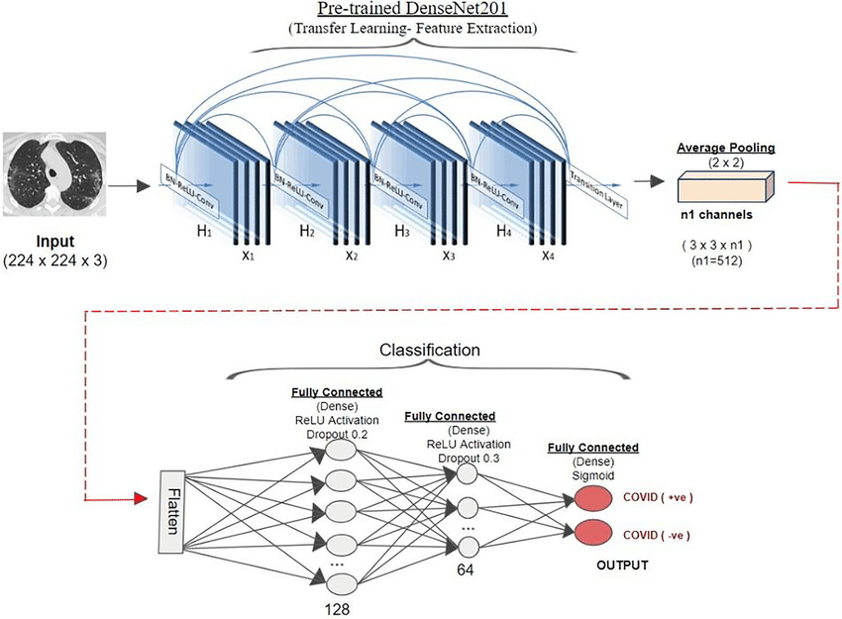
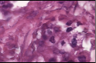
Benign
Malignant

Slide 21
VGG16
VGG16 is a convolutional neural network architecture.
It is characterized by its simplicity and stacking of convolutional layers.
VGG16 architecture consists of 16 layers, including convolutional, pooling, and fully connected layers.
It utilizes small 3x3 filters with a stride of 1, resulting in a deeper network.
The architecture is known for its high capacity to learn complex features and has been widely used for various image classification tasks.

Slide 22
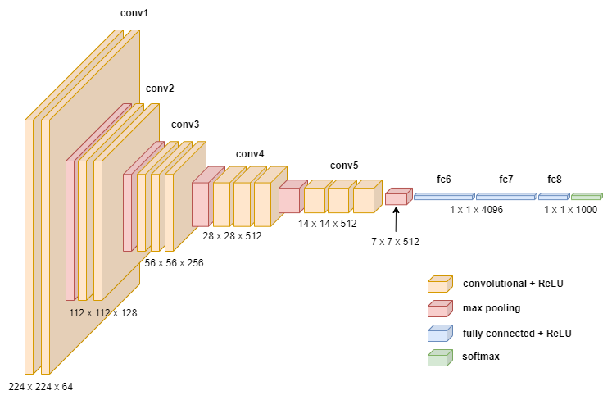
Benign
Malignant

Slide 23
Xception
Xception is a deep neural network architecture with 71 layers.
It is based on the concept of depthwise separable convolutions.
Xception architecture aims to improve efficiency and reduce computational complexity.
It separates spatial and channel-wise transformations using depthwise and pointwise convolutions.
The architecture achieves state-of-the-art performance with fewer parameters and computations compared to traditional convolutional networks.

Slide 24
InceptionResNetV2
InceptionResNetV2 is a deep neural network architecture with 164 layer.
It combines the Inception module and residual connections from ResNet.
The architecture consists of multiple stacked Inception-ResNet blocks.
Each block contains parallel branches with different filter sizes and operations.
InceptionResNetV2 achieves a good balance between accuracy and computational efficiency for breast cancer classification tasks.

Slide 25
Training Model Description
A state of the art model is imported to the top layer of our model, specifying an input shape of (224, 224, 3) to match the expected input dimensions of the pre-trained model.
The output of the imported model is passed through some dense layers. This approach enables us to leverage the features learned by the pre-trained model and further refine them for our specific task.
Adam Optimizer is used with initial learning rate of 0.0001, it is known for its ability to converge quickly and effectively on good parameter values.
The loss function that is Binary Cross Entropy used in binary classification problems, it measures the difference between the predicted probability distribution and the true probability distribution.
The activation function used in our dense layers is relu since it overcomes the vanishing gradient problem which is faced by sigmoid function due to saturation.
The model was trained for 70 epochs and for every epoch the four metrics, i.e., accuracy, precision, recall and auc is observed.

Slide 26
Evaluation Metrics
Accuracy: It evaluates correctness of a model, and is the ratio of the number of images accurately classified out of the total number of testing images. [(TN+TP)/(TP+FP+TN+FN)]
Precision: the quality of a positive prediction made by the model. [TP/(TP+FP)]
Recall: Recall is referred to as the true positive rate or sensitivity.[TN/(TN+FP)]
F1-score: It represents the harmonic average of precision and recall, and is usually used for the optimization of a model towards either precision or recall.[2*((P*R)/(P+R))]

Slide 27
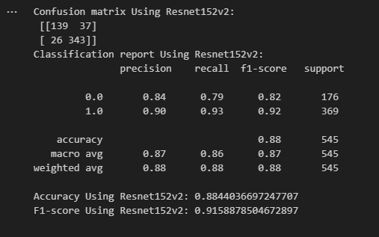
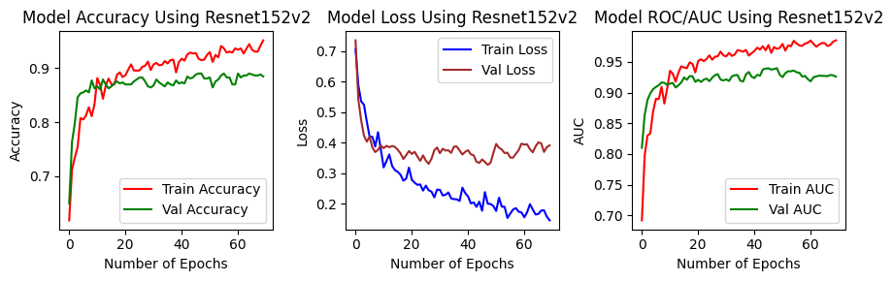
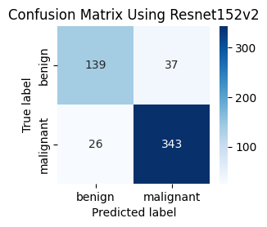
Results

Slide 28
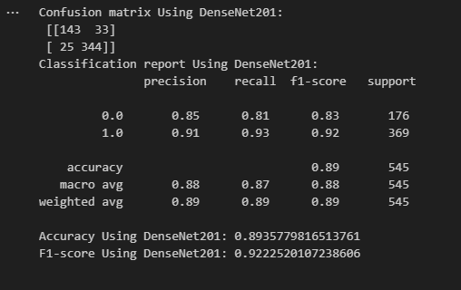
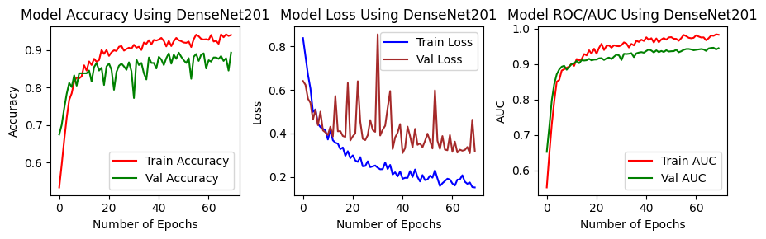
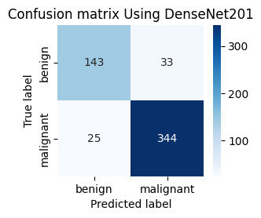
Results

Slide 29
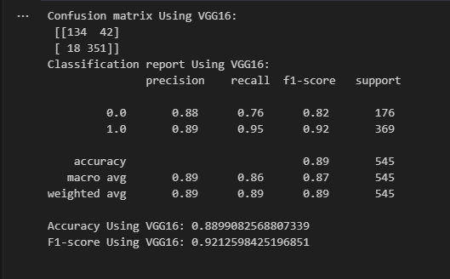
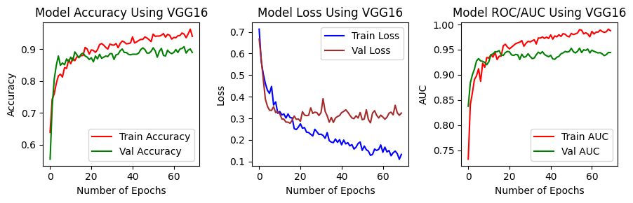
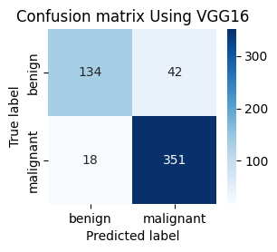
Results

Slide 30
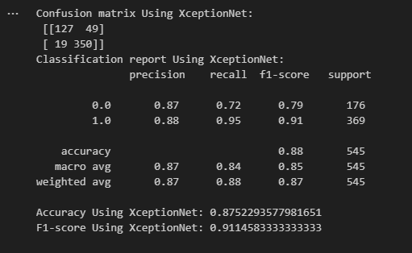
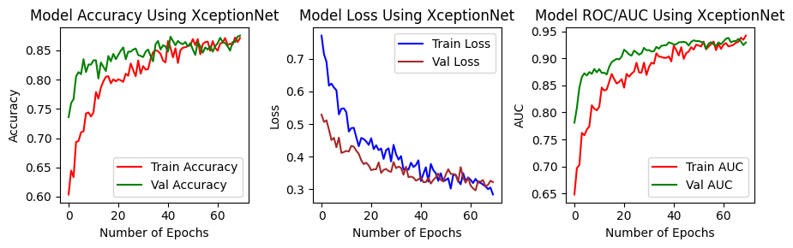

Results

Slide 31
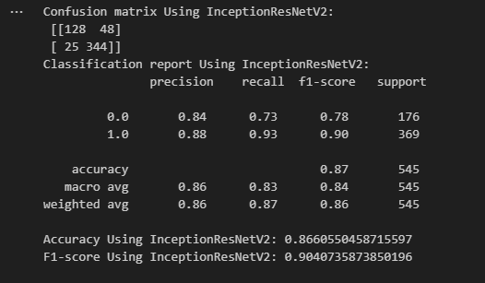
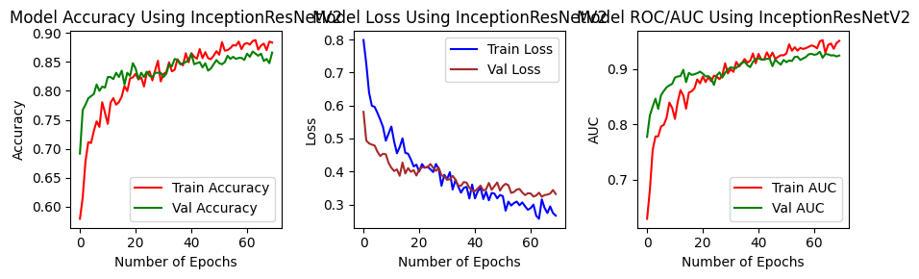
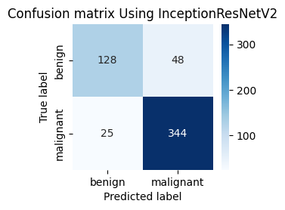
Results

Slide 32
Comparison
Model | Train |  | Validation |  | Test
 | ACC | LOSS | ACC | LOSS | Pre | Re | F1 | ACC
RESNET152V2 | 95.12 | 14.53 | 88.44 | 39.10 | 87 | 86 | 91.58 | 88.44
DENSENET201 | 94.08 | 15.21 | 89.36 | 32.05 | 88 | 87 | 92.22 | 89.35
VGG16 | 94.08 | 13.30 | 88.99 | 32.44 | 89 | 86 | 92.12 | 88.99
XCEPTION | 87.11 | 28.43 | 87.52 | 32.23 | 87 | 84 | 91.14 | 87.52
InceptionResNetV2 | 88.33 | 26.61 | 86.6 | 33.18 | 86 | 83 | 90.40 | 86.60

Slide 33
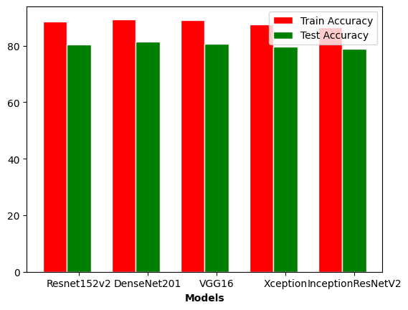
Comparison
We have observed that DenseNet201 model gives highest accuracy.
Train accuracy is higher in comparison with test accuracy, which should be expected.
Each model ranges near 90 percentage accuracy.

Slide 34
Conclusion & Future Work
Conclusion : In previous works, we have seen that, they were not able to investigate further on the speed, space. Models were overfitting and not performing well on generalized datasets. Deep learning models are weak against the low resolution and high noise. Thus, it is vital to work with breast cancer histopathological images of suitable resolution and quality.
Future Work: To apply data argumentation and classification to datasets. To optimize the model to increase the accuracy as well as try to use more and various layers. To implement recent new algorithms to increase accuracy.

Slide 35
References
[1] Y. Li, J. Wu and Q. Wu, "Classification of Breast Cancer Histology Images Using Multi-Size and Discriminative Patches Based on Deep Learning," in IEEE Access, vol. 7, pp. 21400-21408, 2019, doi: 10.1109/ACCESS.2019.2898044.
[2] A. Ijaz et al., "Modality Specific CBAM-VGGNet Model for the Classification of Breast Histopathology Images via Transfer Learning," in IEEE Access, vol. 11, pp. 15750-15762, 2023, doi: 10.1109/ACCESS.2023.3245023.
[3] A. Saber, M. Sakr, O. M. Abo-Seida, A. Keshk and H. Chen, "A Novel Deep-Learning Model for Automatic Detection and Classification of Breast Cancer Using the Transfer-Learning Technique," in IEEE Access, vol. 9, pp. 71194-71209, 2021, doi: 10.1109/ACCESS.2021.3079204..
[4] F. Shahidi, S. Mohd Daud, H. Abas, N. A. Ahmad and N. Maarop, "Breast Cancer Classification Using Deep Learning Approaches and Histopathology Image: A Comparison Study," in IEEE Access, vol. 8, pp. 187531-187552, 2020, doi: 10.1109/ACCESS.2020.3029881.
[5]J. Zheng, D. Lin, Z. Gao, S. Wang, M. He and J. Fan, "Deep Learning Assisted Efficient AdaBoost Algorithm for Breast Cancer Detection and Early Diagnosis," in IEEE Access, vol. 8, pp. 96946-96954, 2020, doi: 10.1109/ACCESS.2020.2993536.

Slide 36
Thank You!!

